Slide 1


Nura Arifin Wong
25 October 2025

Slide 2

Outline
Executive Summary
Introduction
Methodology
Results
Conclusion
Appendix

Slide 3
Executive Summary
Summary of methodologies
Summary of all results

Slide 4
Introduction
Project background and context
Problems you want to find answers

Slide 5

Section 1

Slide 6
Methodology
Executive Summary
Data collection methodology:
Data can be collected from web API or web scraping of wiki page. For downstream analyses, data used was from Coursera provided csv files
Perform data wrangling
Some parameters were converted to one-hot-encoding style (i.e., categorical variables were converted binary)
Perform exploratory data analysis (EDA) using visualization and SQL
Perform interactive visual analytics using Folium and Plotly Dash
Perform predictive analysis using classification models
How to build, tune, evaluate classification models

Slide 7
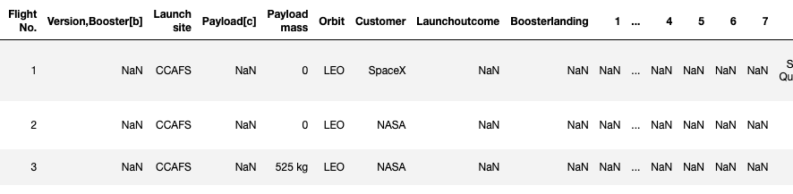
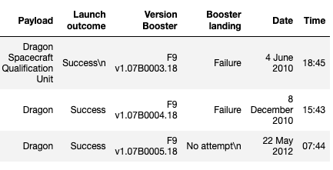
Data Collection
Method 1: SpaceX API (https://api.spacexdata.com/v4)
Method 2: Web scrapped Wiki page (https://en.wikipedia.org/w/index.php?title=List_of_Falcon_9_and_Falcon_Heavy_launches&oldid=1027686922)

Slide 8
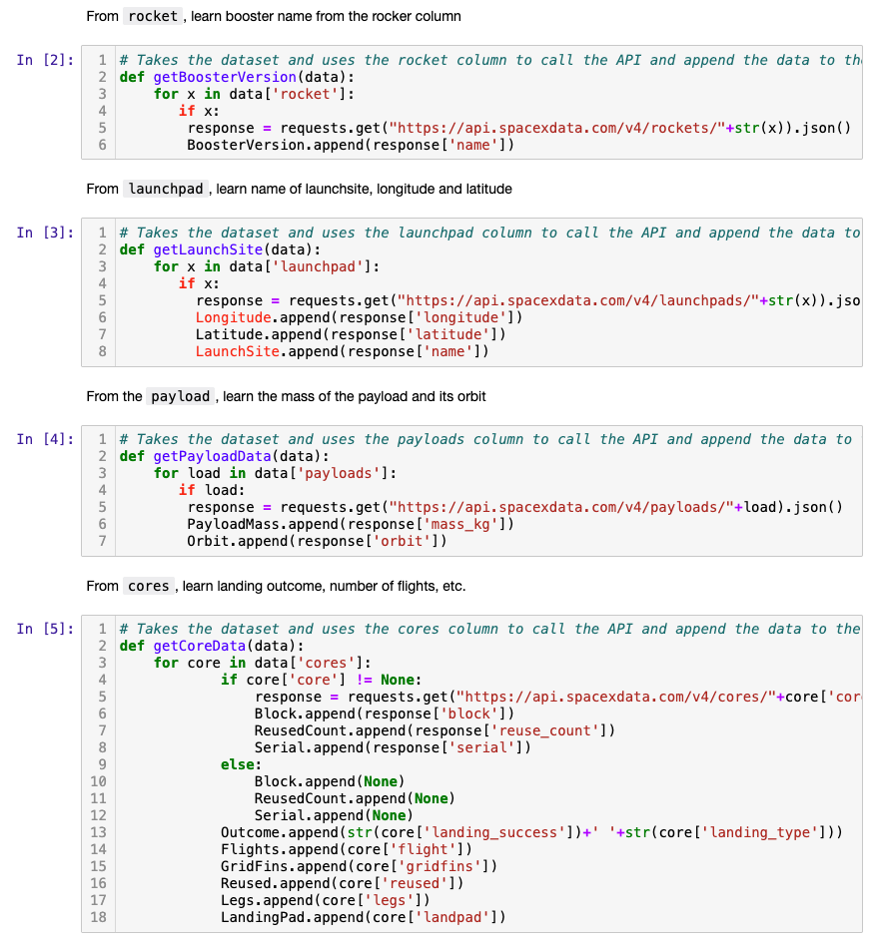
Data Collection – SpaceX API
Coursera provided auxiliary functions to get API data
Parsing and cleaning json get requests
GitHub URL: https://github.com/n-arifinwong/coursera_notes/blob/main/capstone/M1_1_DataWebAPI.ipynb

Slide 9
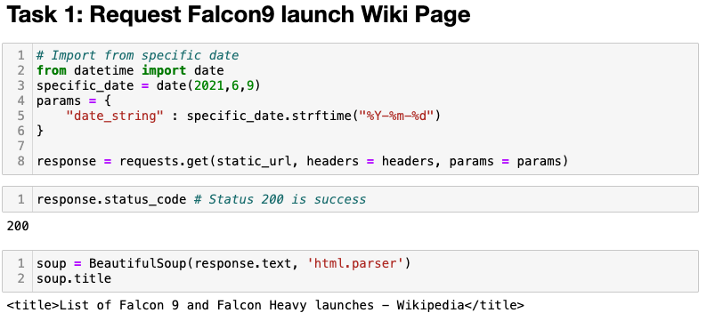
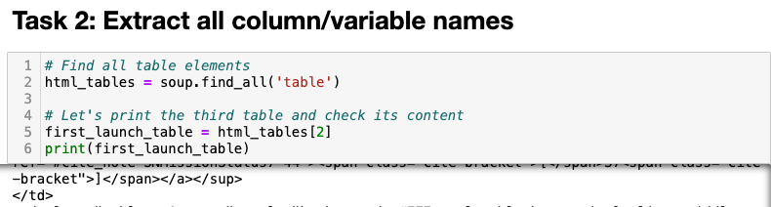
Data Collection - Scraping
Get request of Falcon9 Wiki page
Parsing and clean the output using BeautifulSoup
GitHub URL: https://github.com/n-arifinwong/coursera_notes/blob/main/capstone/M1_1_DataWebAPI.ipynb

Slide 10
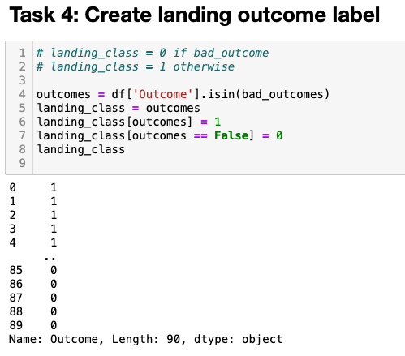
Data Wrangling
Verified the number of null values: df.isnull().sum()/len(df)*100
Turned the landing outcome label into one-hot-encoding format (0 if failure, 1 if success)
GitHub URL: https://github.com/n-arifinwong/coursera_notes/blob/main/capstone/M1_3_dataWrangling.ipynb

Slide 11
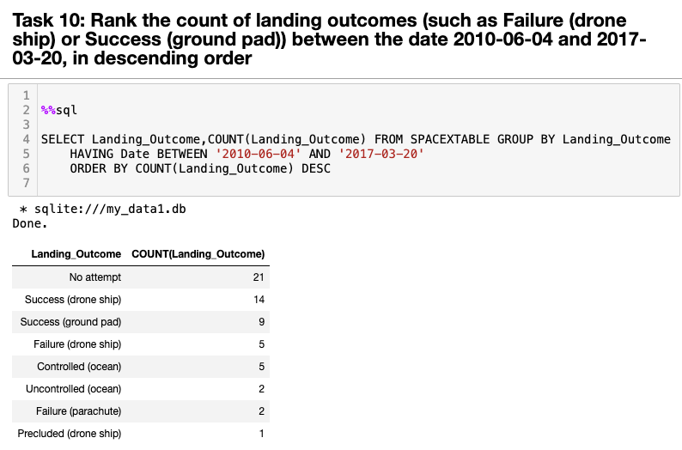
EDA with SQL
First, explored data using SQLite python magics
GitHub URL:
https://github.com/n-arifinwong/coursera_notes/blob/main/capstone/M2_1_EDA_withSQL.ipynb
For example:

Slide 12
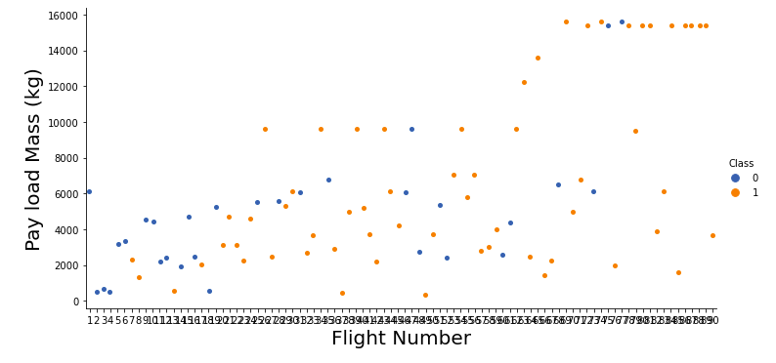
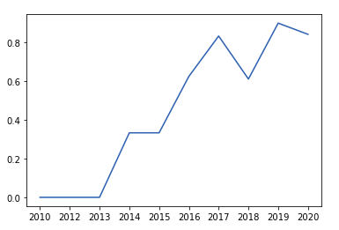
EDA with Data Visualization
For example: Pay load mass by flight number, coloured by success/failure
Yearly trend of average launch success:
Second, visualized data using matplotlib and seaborne
GitHub URL:
https://github.com/n-arifinwong/coursera_notes/blob/main/capstone/M2_2_EDA_Visualization.ipynb

Slide 13
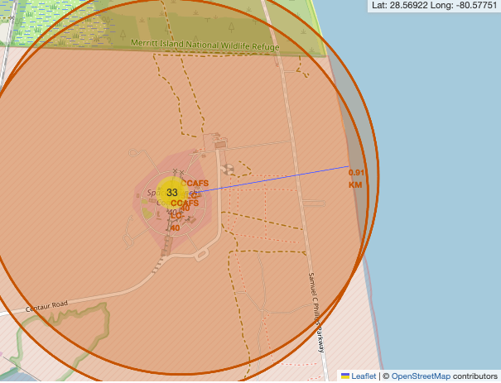
Build an Interactive Map with Folium
Used Folium package to visualize launch sites on a map, marked with circles/points
Success/failures indicated
Distance to closest coastline drawn using polyline (pictured)
GitHub URL:
https://github.com/n-arifinwong/coursera_notes/blob/main/capstone/M3_1_foliumMaps.ipynb

Slide 14
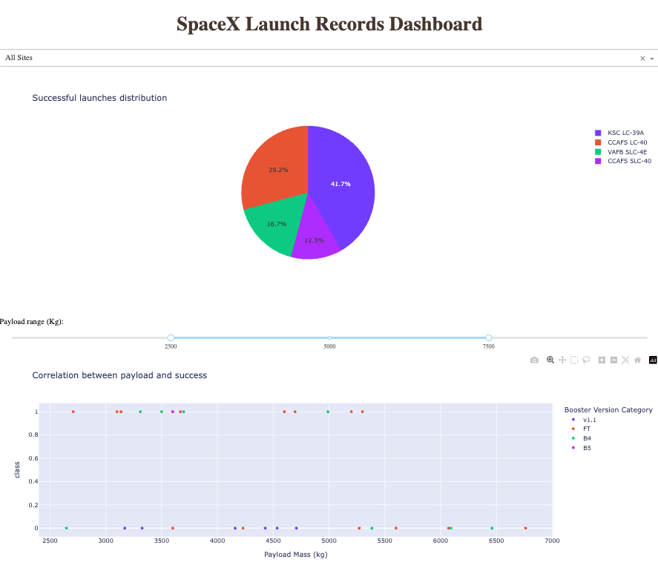
Build a Dashboard with Plotly Dash
Interactive dashboard to visualize launch successes
To run: python3.11 spacex-dash-app.py #Then open html link
GitHub URL: https://github.com/n-arifinwong/coursera_notes/blob/main/capstone/1_data/dash/spacex-dash-app.py

Slide 15
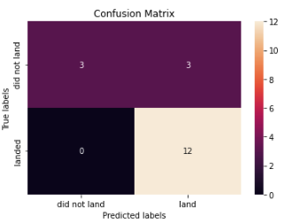
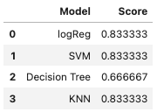
Predictive Analysis (Classification)
Confusion matrix output from all models:
Accuracy score:
Used GridSearch cross validation for hyperparameter tuning
Used prediction models: logistic regression, svm, decision tree and KNN
All models had similar accuracy (with decision tree sometimes performing worse, depending on random seed)
GitHub URL: https://github.com/n-arifinwong/coursera_notes/blob/main/capstone/M4_predictiveAnalysis_classification.ipynb

Slide 16
Results
Exploratory data analysis results
Interactive analytics demo in screenshots
Predictive analysis results

Slide 17

Section 2

Slide 18
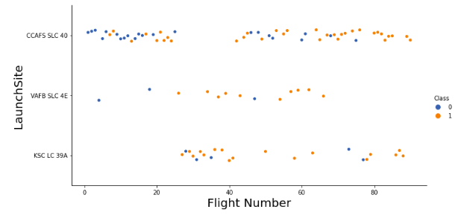
Flight Number vs. Launch Site
VAFB SLC 4E had very few launches in comparison to other 2 sites
CCAFS LC 40 Had the first few launches, which looked to have a few failures. But more recent launches were mostly successful

Slide 19
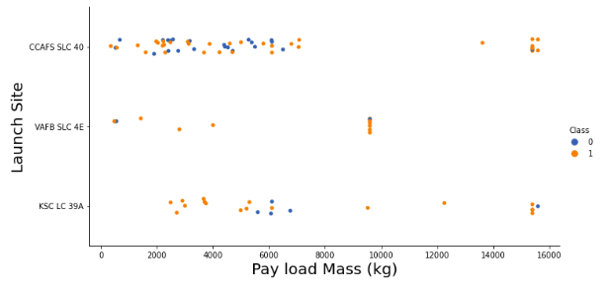
Payload vs. Launch Site
High pay load mass seems to be rather successful
But most of the launches have low pay load mass
None of the launches from site VAFB SLC 4E were high pay load mass

Slide 20
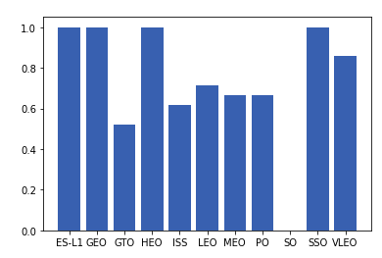
Success Rate vs. Orbit Type
Orbit type ES-L1, GEO, HEO, and SSO have 100% success rates
Orbit type SO has 0% success rate
Other orbits have ~50-90% success rate

Slide 21
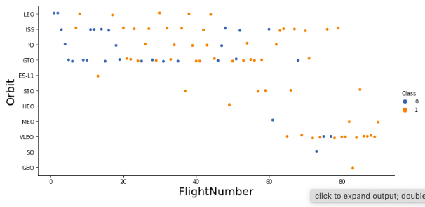
Flight Number vs. Orbit Type
More recent flights go into VLEO orbit
Earlier flights in LEO, ISS, PO, and GTO were likely failures

Slide 22
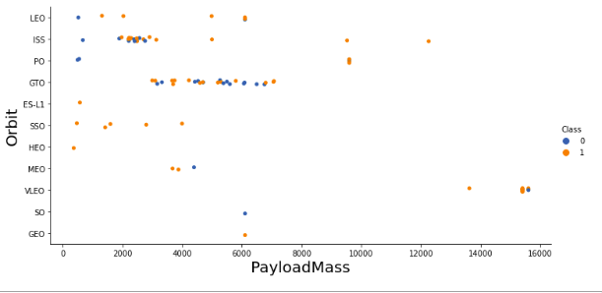
Payload vs. Orbit Type
Higher pay load mass launches went into VLEO orbit

Slide 23
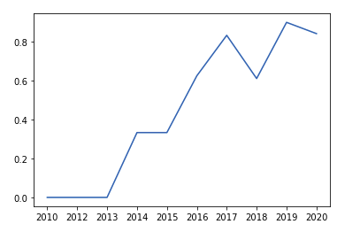
Launch Success Yearly Trend
Success rate tends to be a rising trend, except for a dip in year 2018
Success rate in earlier years (2010-2013) were 0%

Slide 24
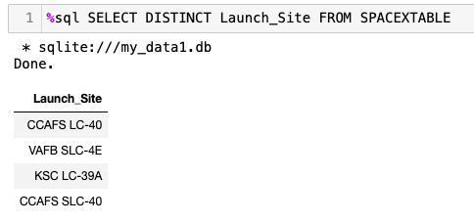
All Launch Site Names
There are 3 unique launch sites:
CCAFS SLC 40
VAFB SLC 4E
KSC LC 39A
CCAFS SLC-40

Slide 25
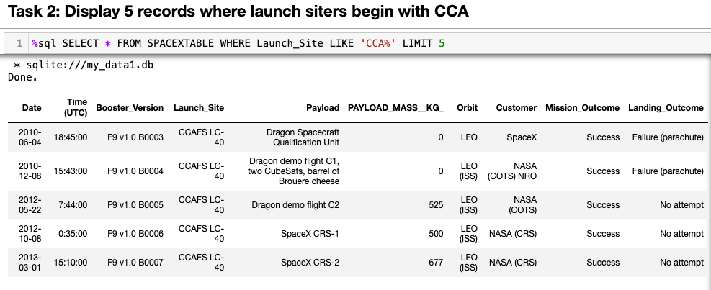
Launch Site Names Begin with 'CCA'
Printed 5 records of launch sites starting with CCA

Slide 26
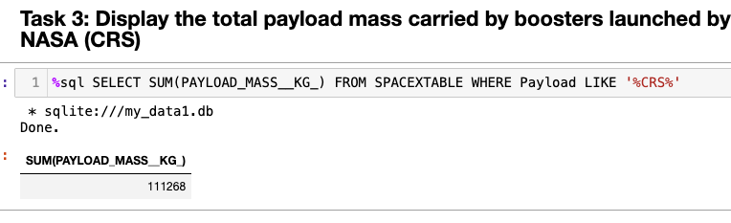
Total Payload Mass
Total pay load mass = 111268 kg

Slide 27
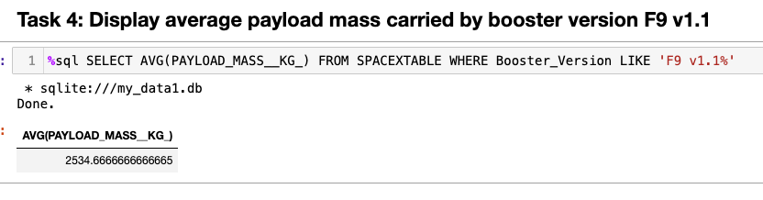
Average Payload Mass by F9 v1.1
Calculate the average payload mass carried by booster version F9 v1.1
Average pay load mass carried by booster version F9 v1.1 = 2534.97 kg

Slide 28
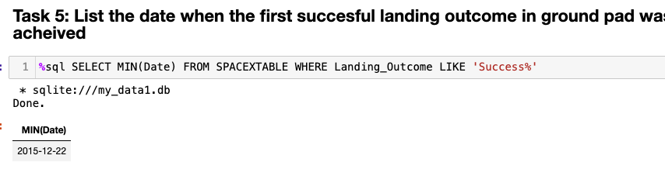
First Successful Ground Landing Date
The first successful ground landing was on December 22nd 2015

Slide 29
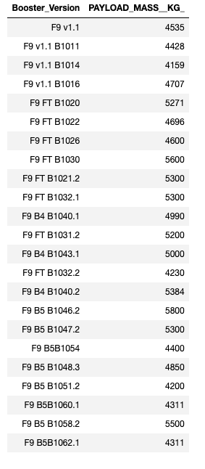
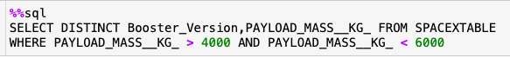
Successful Drone Ship Landing with Payload between 4000 and 6000
All the booster versions in the table pictured

Slide 30
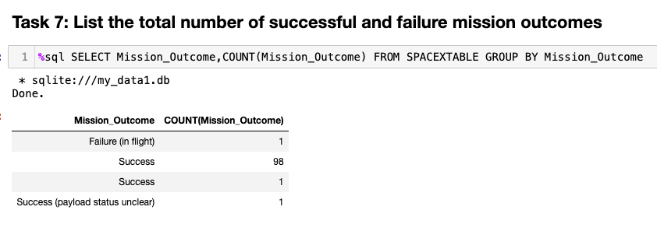
Total Number of Successful and Failure Mission Outcomes
Mission outcomes were mostly successes

Slide 31
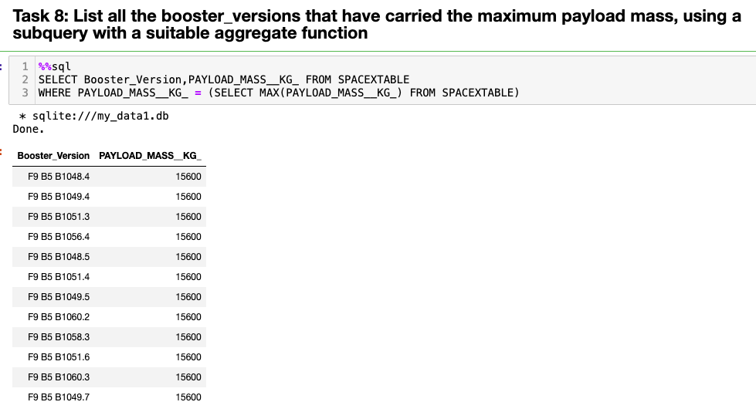
Boosters Carried Maximum Payload
The boosters are tabulated below:

Slide 32
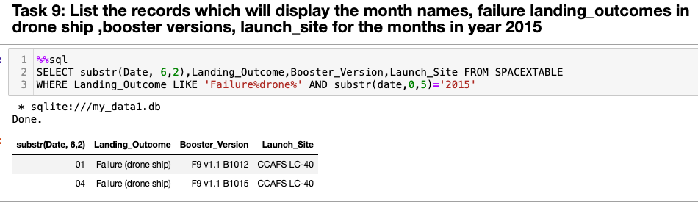
2015 Launch Records
List the failed landing_outcomes in drone ship, their booster versions, and launch site names for in year 2015:

Slide 33
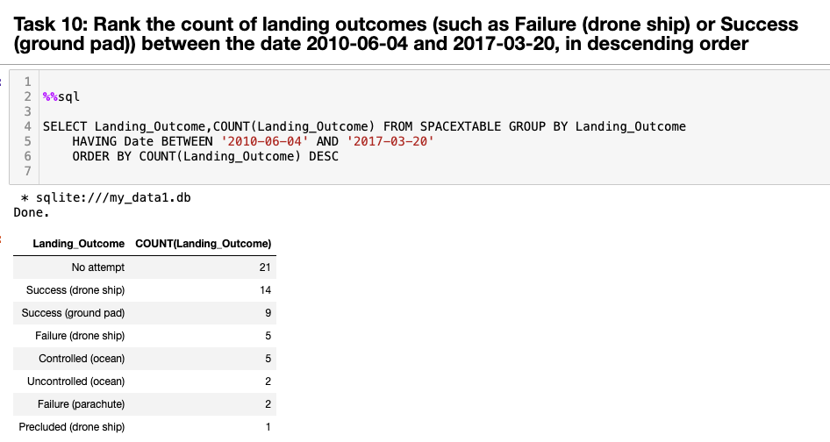
Rank Landing Outcomes Between 2010-06-04 and 2017-03-20
Ranked landing outcomes:

Slide 34

Section 3

Slide 35
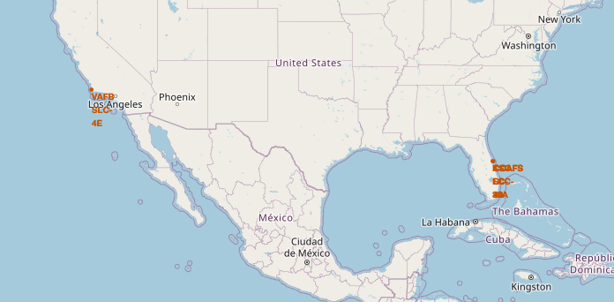
All launch sites on map
There were a total of 4 launch sites (pictured below)
Launch sites KSC LC-39A, CCAFS LC-40, and CCAFS SLC-40 are very close to each other and appear to be overlapping
VAFB SLC-4E is far away from the others

Slide 36
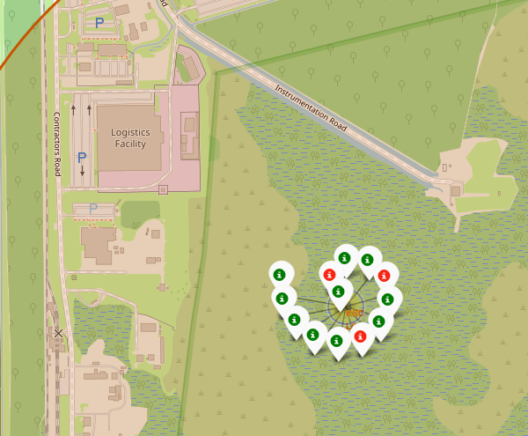
Launch successes from KSC LC-39A site
Red = failure
Green = success
Total 13 launches and a ~78% success rate

Slide 37
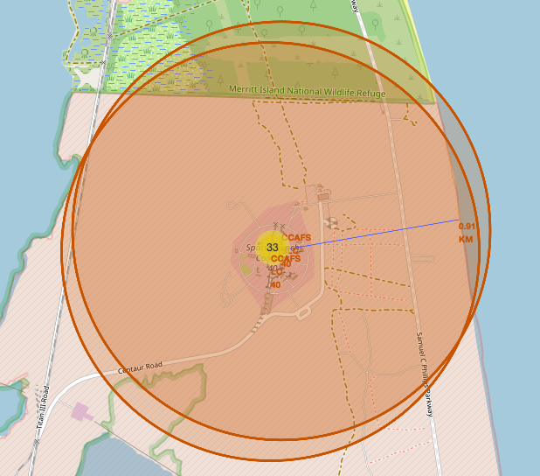
<Folium Map Screenshot 3>
CCAFS launch sites are about 0.91 KM away from the coastline
But a wildlife refuge North from the launch site is closer
The launch site must have disaster preparedness protocols to minimize impact to the ecology of the wildlife refuge, during a worst-case-scenario

Slide 38

Section 4

Slide 39
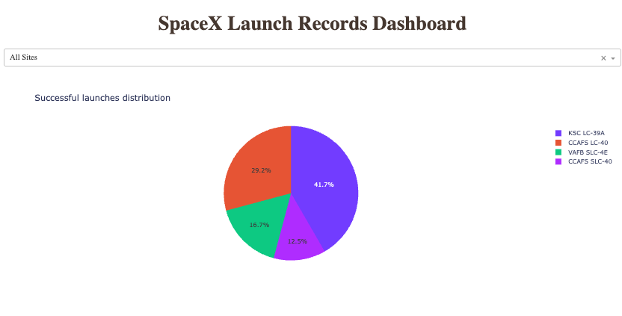
Launch Success of All Sites
KSC LC-39A seems to have the greatest share of successful launches (41.7%), followed by CCAFS LC-40 (29.2%), VAFB SLC-4E (16.7%) and CCAFS SLC-40 (12.5%)

Slide 40
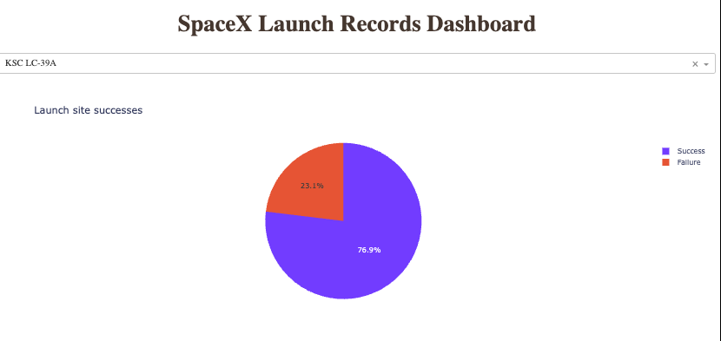
KSC LC-39A has the highest launch success rate
KSC LC-39A has the highest successful launch rate (76.9% of the total launches)

Slide 41
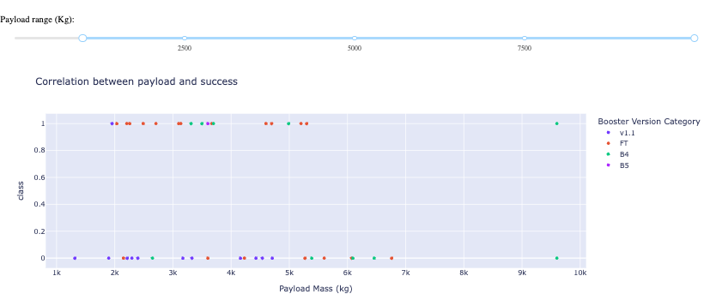
Successful launches by payload range
Booster version category FT seems to have a lot of successful launches
Booster version B4 had the highest payload mass, but resulted in one successful and one failure at that mass

Slide 42

Section 5

Slide 43
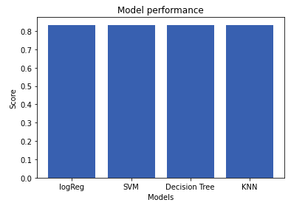
Classification Accuracy
All the models performed equally well, with an accuracy of 0.84

Slide 44
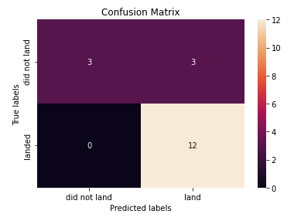
Confusion Matrix
Confusion matrix of all models were the same
0 false negatives (predicted no landing when actually landed)
3 false positives (predicted landed when actually no landing)

Slide 45
Conclusions
The predictor models can estimate the landing success to quite a high level of accuracy
Before any future launches, the rocket data can be input in the model to predict the outcome
However, one caveat is that the dataset is quite heavily skewed to be mostly landed outcomes
An improvement of the model could include stratified cross validation, leading to more reliable prediction

Slide 46
Appendix
NA

Slide 47


